Slide 1
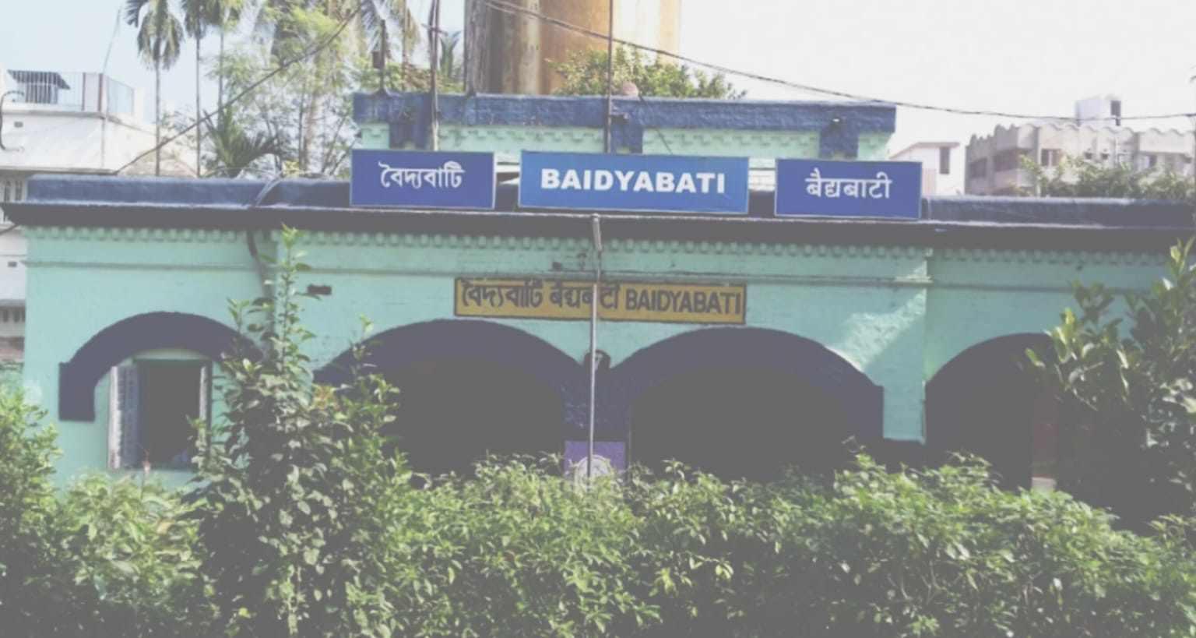
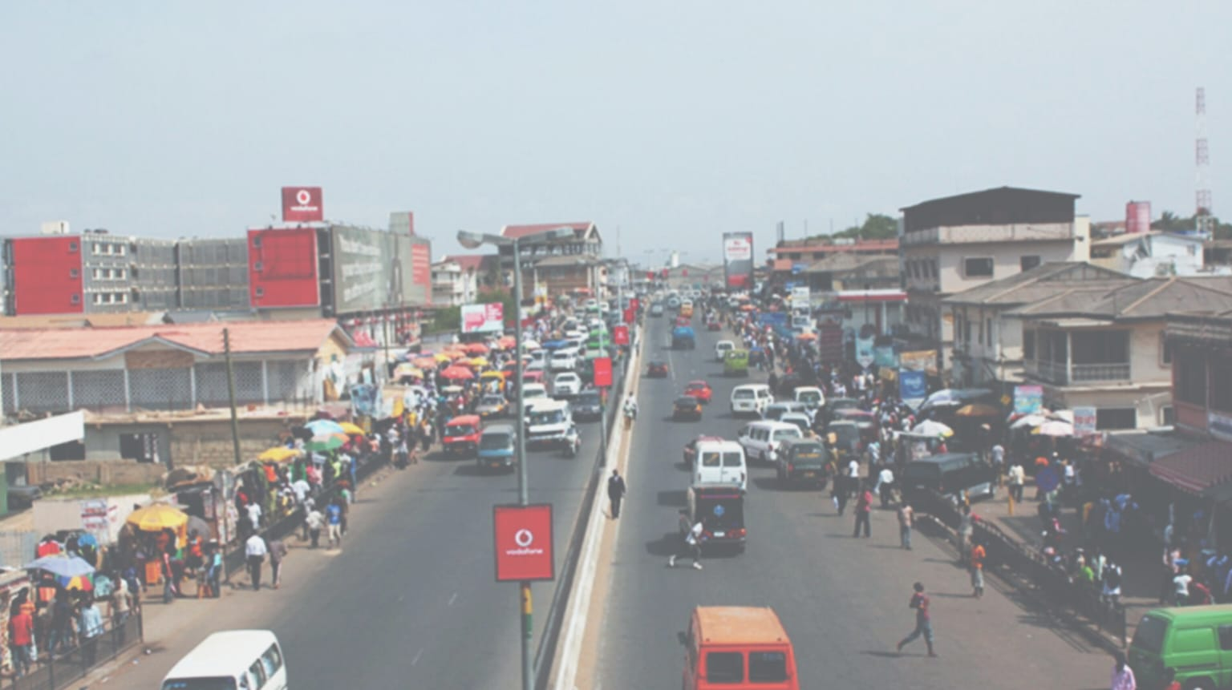
CHANGING URBAN GROWTH:
IMPACT ON THE PEOPLE OF BAIDYABATI, HOOGHLY

Slide 2
BIJOY KRISHNA GIRLS’ COLLEGE, HOWRAH
AFFFILIATED TO
UNIVERSITY OF CALCUTTA
GEOGRAPHY DISSERTATION WORK
SUBMITTED BY
DIYA SAHA
MODULE-420A
SUPERVISED BY- DR. ASMITA MUKHERJEE
M.SC 4TH SEMESTER EXAMINATION
SESSION- 2022-2024
UNIVERSITY ROLL NO - 411/GEO/221145
UNIVERSITY REGISTRATION NO- 026-1211-0066-19

Slide 3
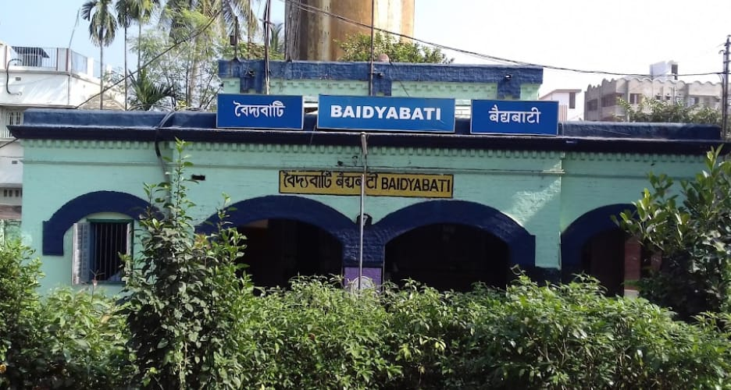
INTRODUCTION -
Urbanization is a very complex process. It is the population shift from rural to urban areas, and the way by which society adopts the changes. Urbanization leads to environmental degradation, industrial expansion, ecological imbalance, and mining. Also leads to commercialization, industrialization and provides people with housing, electricity, and clean water. It occurs primarily in search of job opportunities, shelter, foods etc. Baidyabati is located in the Hooghly district of West Bengal in India. This district town has seen many changes, communicative developments such as railway Connection, also some convenient options have been provided to the common mass to communicate via the main road, directly accessible to the highways and certainly, the water transport system being able to be one of the most significantly considered way of communication here.
OBJECTIVES-
To analyse land use and land cover changes in baidyabati the year of 2001,2011 and 2021.
To detect positive and negative impact of urbanization and identify the driving factors of urbanisation and urban expansion in the Baidyabati of ward 9 and 17.
Photo 1: Study area-Baidyabati

Slide 4
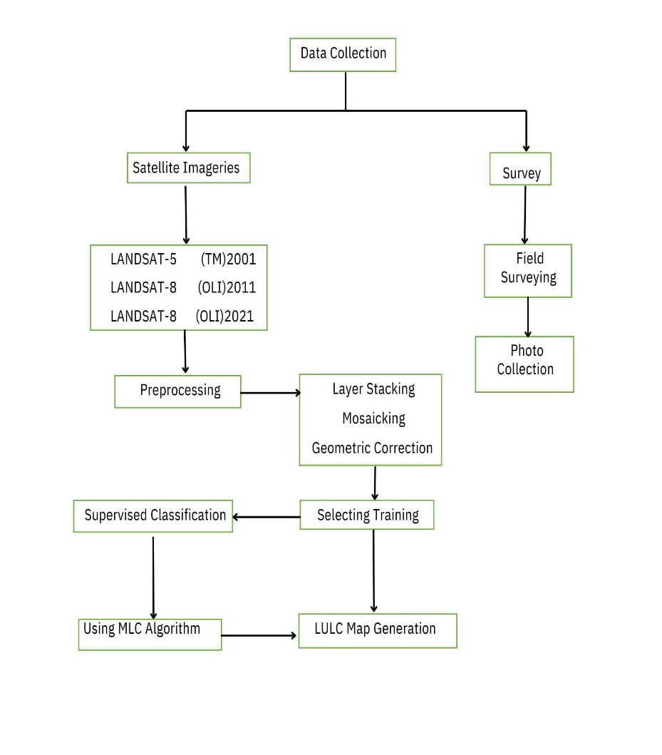
METHODOLOGY-
The entire work has been done by three phases:
Pre-field work
Field work
Post field-work
LOCATION OF THE STUDY AREA –
The study area is situated in parts of ward no 17and ward no 9 of Baidyabati municipality. It includes almost 3.9 square km area and extends from 88°19'4" East to 88°20'30" East longitude and from 22°47'31" seconds North to 22°48'39" North latitude. It is included in Kolkata Metropolitan Area.
Flow chart showing the methodology for preparation of LULC maps

Slide 5
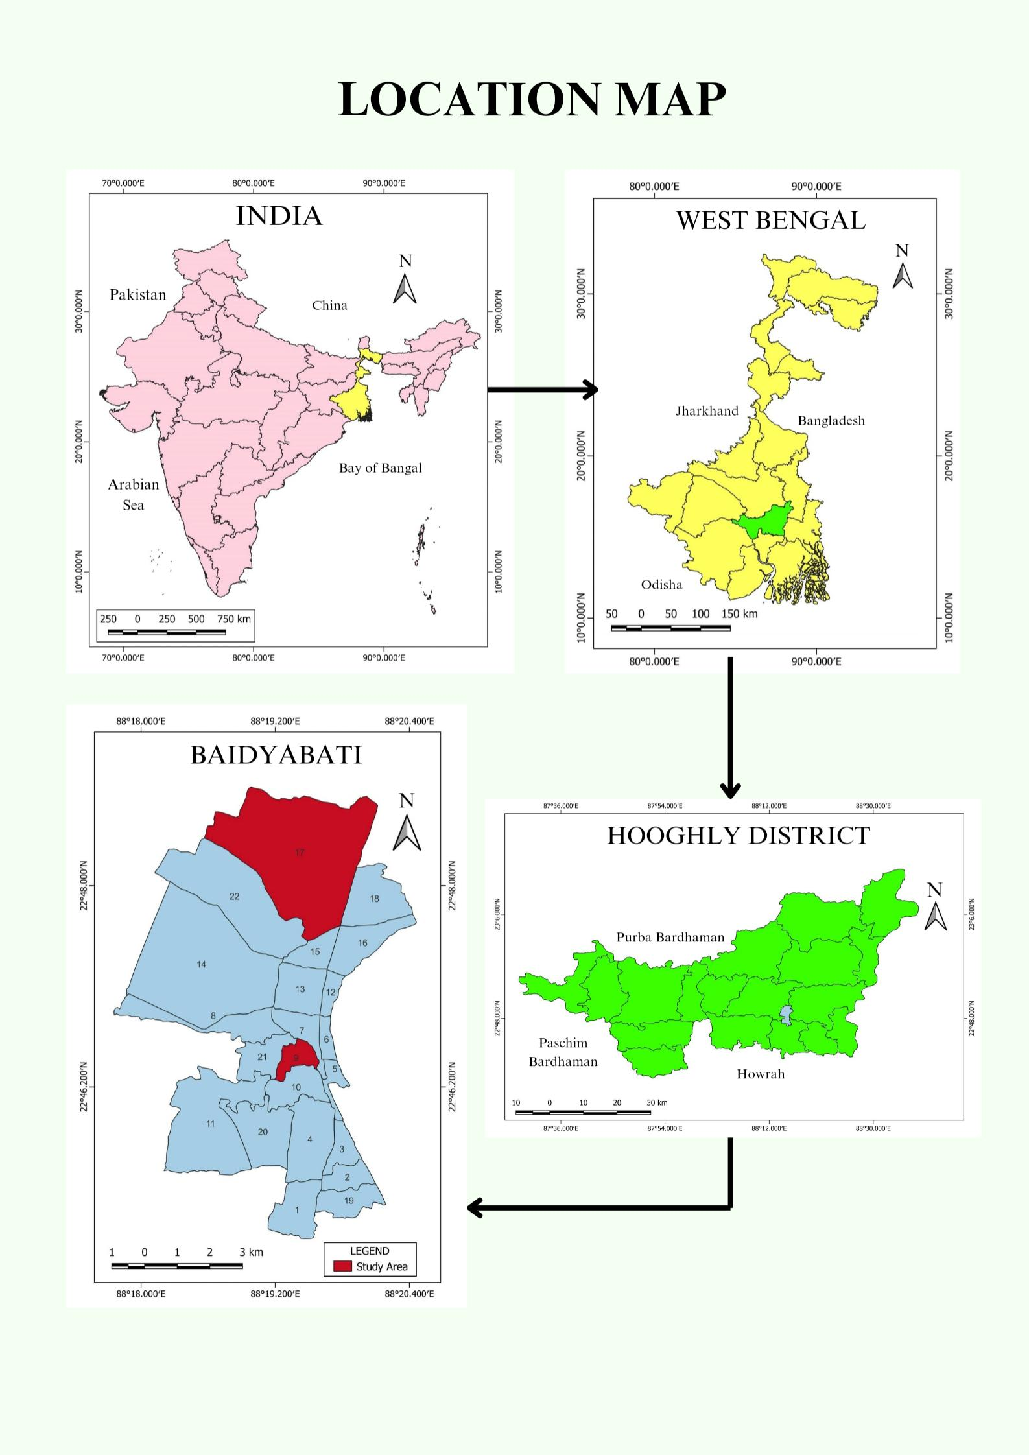
Source: Census of India, computed by me

Slide 6
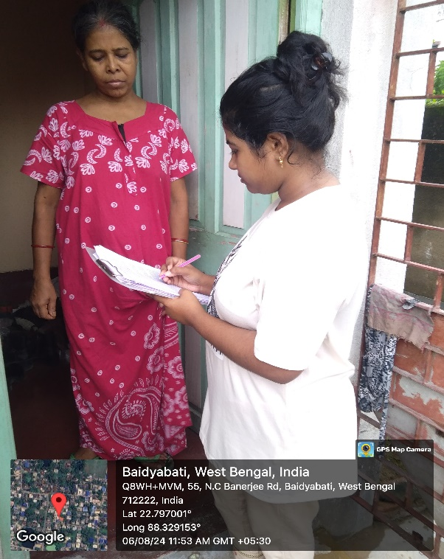
Physical set up and demographical structure of Baidyabati:
Source: Census of India 2011&2021
Source: Baidyabati Municipality
AREA OF BAIDYABATI- 12.09 sq.km
AREA OF WARD 9- 1.2 sq.km
AREA OF WARD 17- 2.7 sq.km
Photo.2: Collect information from ward no 17, 145/15 N.C.B Road

Slide 7
Source- Census of India 2001,2011,2021
Source: Census of India 2001,2011,2021
Source- Census of India 2001,2011,2021
Source: Primary survey

Slide 8
Objective-1
Analysis of the landuse and landcover changes in Baidyabati 2001, 2011, & 2021:
Table-1: Satellite Imagery Dataset
Satellite | Date of Acquisition | Sensor | Path/Row | Spatial Resolution | Source
Landsat 5 | 2001-02-13 | TM | 139/41,42 | 30 M | USGS GLOVIS
Landsat 5 | 2011-02-09 | TM | 139/41,42 | 30 M
Landsat 8 | 2021-11-07 | OLI | 139/41,42 | 30 M
Source: USGS, QGIS-3.10,3.28

Slide 9
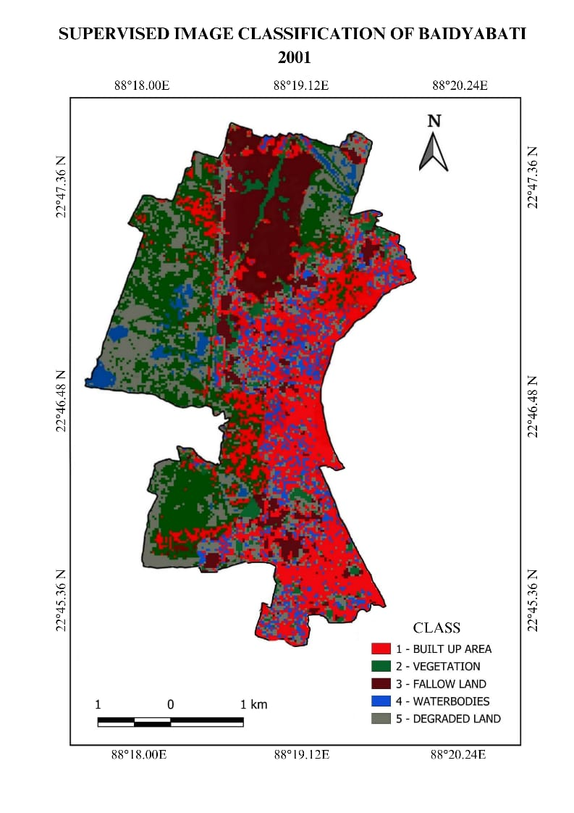
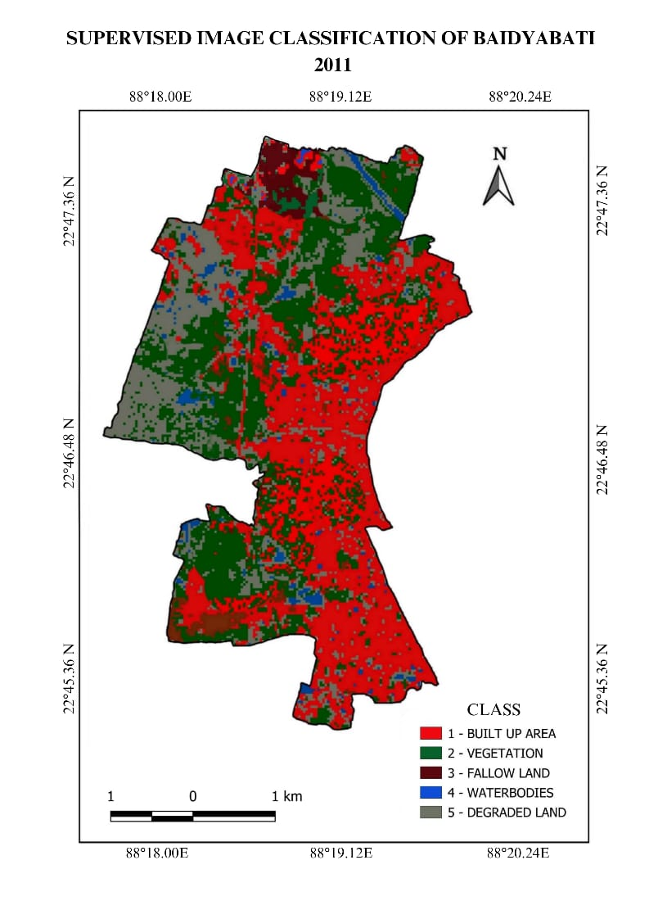
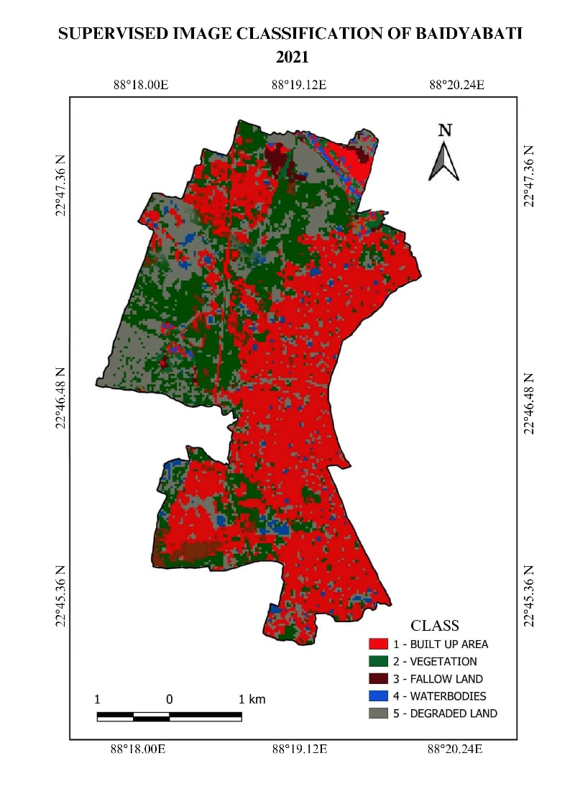
SUPERVISED IMAGE CLASSIFICATION OF BAIDYABATI (2001, 2011, &2021)
Source: USGS, QGIS-3.10,3.28

Slide 10
% OF LANDUSE & LANDCOVER CHANGES IN BAIDYABATI (2001,2011,2021)-
Source: USGS QGIS-3.10,3.28

Slide 11
Table 2: Land use change (2001-2011)
Table 3: Land use change (2011-2021)
Sl. No. | Land Use Categories | 2001 |  | 2011 |  | Land Use change (2001-2011)
 |  | Area |  | Area |  | Area
 |  | (km2) | (percent) | (km2) | (percent) | (km2) | (percentage)
1 | Built-up area | 2.0956 | 17.42 | 3.8050 | 31.63 | 1.7094 | 14.0771
2 | Vegetation | 3.9314 | 32.68 | 2.9377 | 24.42 | -0.9937 | -8.1832
3 | Fallow land | 1.6615 | 13.81 | 0.8613 | 7.16 | -0.8002 | -6.58975
4 | Water body | 1.1067 | 9.2 | 0.6255 | 5.2 | -0.4812 | -3.96274
5 | Degraded land | 3.3479 | 27.83 | 3.3996 | 28.26 | 0.0517 | 0.42575
 | Total | 12.1431 | 100 | 12.1431 | 100
Sl. No. | Land Use Categories | 2011 |  | 2021 |  | Land use change (2011-2021)
 |  | Area |  | Area |  | Area
 |  | (km2) | (percent) | (km2) | (percent) | (km2) | (percentage)
1 | Built-up area | 3.8050 | 31.63 | 5.2486 | 43.63 | 1.4436 | 11.8882
2 | Vegetation | 2.9377 | 24.42 | 2.3434 | 19.48 | 0.5932 | 4.8850
3 | Fallow land | 0.8613 | 7.16 | 0.4523 | 3.76 | -0.409 | -3.3681
4 | Water body | 0.6255 | 5.2 | 0.50526 | 4.2 | -0.12034 | -0.9910
5 | Degraded land | 3.3996 | 28.26 | 2.987049 | 24.83 | -0.412551 | -3.39741
 | Total | 12.1431 | 100 | 12.1431 | 100
Source: USGS, QGIS-3.10,3.28
Source: USGS, QGIS-3.10,3.28

Slide 12
Objective:2.
Positive and negative impact of urbanization and identifying the driving factor of urbanisation and urban expansion in baidyabati ward no 9 & 17
Source: Primary survey
Source: Primary survey

Slide 13
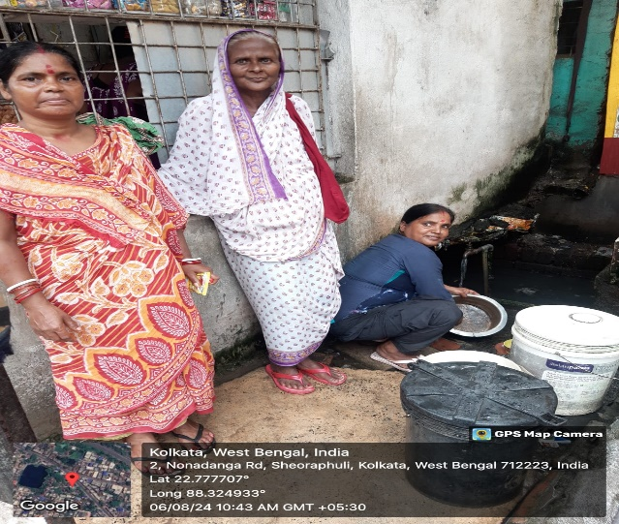
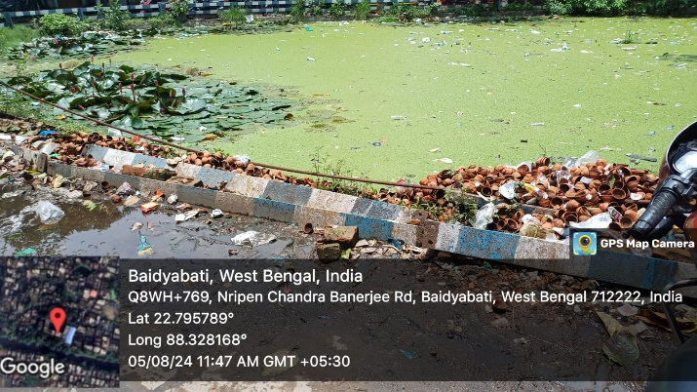
Source: Primary survey
Source: Primary survey
Photo : Municipality taps, ward 9, Nonadanga road, Sardar Para slum.
Source: Primary survey
Source: Primary survey
Photo : Pond condition in ward 9

Slide 14
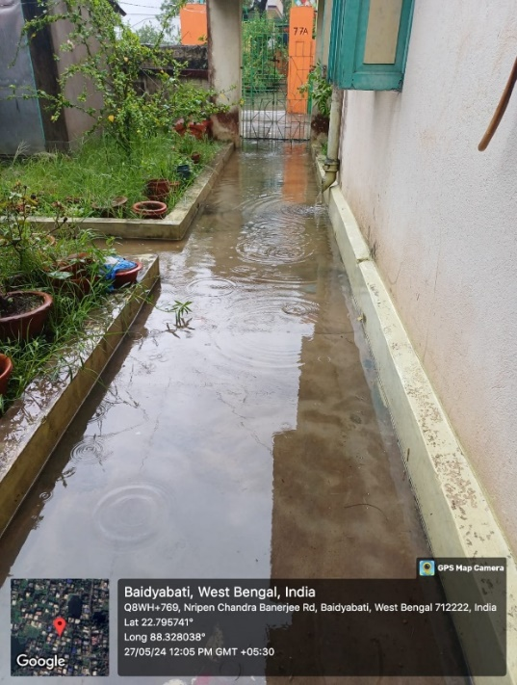
Source: Primary survey
Source: Primary survey
Source: Primary survey
Photo : Water logging in ward 17

Slide 15
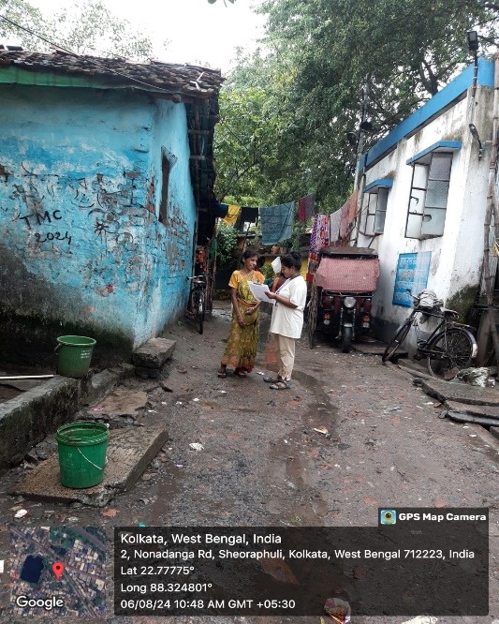
Source: Primary survey
Source: Primary survey
Photo : Road condition in ward 9
Source: Primary survey
Source: Primary survey

Slide 16
Source: Primary survey
Source: Primary survey
Source: Primary survey
Source: Primary survey

Slide 17
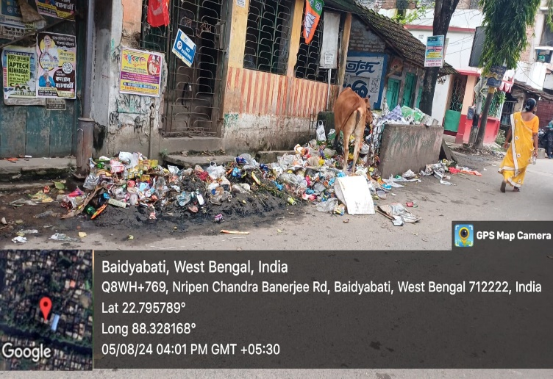
Source: Primary survey
Photo : Garbage disposal in ward 9
Source: Primary survey
Source: Primary survey

Slide 18
Source: Primary survey

Slide 19
FINDINGS-
Development or Progress can never be resisted. With the day by day increasing demands of every other thing, causing Urbanization towards the same way. 2014-2024 all the changes taken place have impacted the residents well, both positive and negative, positively the health facilities and transport facilities, more educational options been renovated, garbage cleaning quite regularly. On the other side all the negative aspects as ponds, playgrounds been decreasing in numbers, excessively traffic issues, been taking place.
The main finding about this area:
With the increasing demands of the mobile phones, the local area xerox shops have turned into the business related to mobiles.
Some local vegetable sellers have now been selling flat breads now.
Some people shifting their own houses into playschools for the sake of the goodness of children with its upward growth of the demands of those playschool education.
Maximum local restaurants have been turning themselves into some hugely decorated high profile restaurants occasionally more crowded.
The enclosed industry been rebuilt as newly malls, all types of business shifts in addition.
Hence, Government must focus more on the infrastructure and facilities of Baidyabati.

Slide 20
CONCLUSION-
This district town has been hugely under the impact of Urbanization, with all the advance facilities being offered to the convenience for the local citizens such as, the extension of the National Highways also the modernization of the Railway Connections, with the new establishments, in those areas where people were lacking behind the necessary amenities related to take care of their health and their kids future such as New Health Care Centre, or High Schools or Primary Schools. But not to forget that all these aspects of Urbanization seen in those ward no's are not deprived of their own negative aspects too in the lives of the residents. Changing urban growth is necessary but not at the cost of degraded biodiversity, climate change, global warming etc. Proper planning and measure should be taken into consideration before developing shopping mall, high rise multiplex etc.
REFERENCES-
Bhalla S, (2011), Inclusive and Growth in India: Some facts, some conclusions, Asia Research Centre for Global Development,5(4).
Burdett.M., (2018), Case study: Urban growth and urbanization.
Chand, Brar.K.K, Kumar.A., (2021): Landuse/cover change detection in high altitude mountain landscapes: a case study of pangi valley, western Himalaya (India). https://cwejournal.org/vol3no3/pland-use-cover-change-detection-in-high-altitude-mountain-landscapes-a-case-of-pangi-valley-western-himalaya-indiap
Chandna. R.C., Population Geography, Kalyani publisher, Ludhiyana.
Chandna. R.C., Regional Geography, Kalyani publisher, Ludhiyana.
Sarma. H., (2014), Urbanization, and its impact on environment.

Slide 21
THANK YOU

